Slide 1
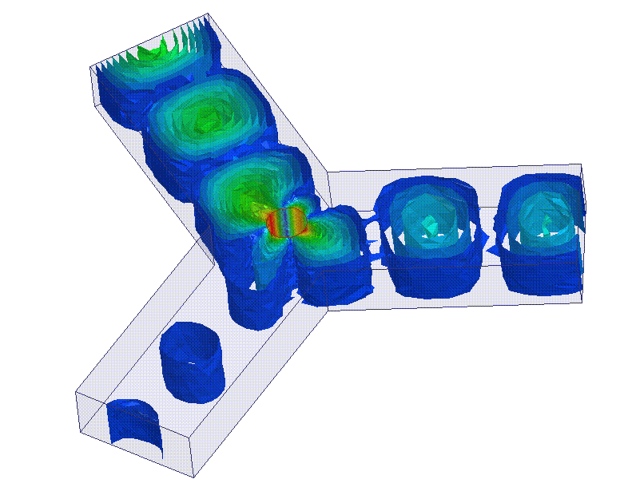
Towards W-band self-biased circulators for next generation of VHTS payload
E. Roue¹⁻², A. Chevalier¹, G. Tanné¹, R. Lebourgeois³, O. Vendier⁴, R. Jaoui⁵, V. Laur¹
¹Lab-STICC, University of Brest
²CNES
³Thales Research & Technology
⁴Thales Alenia Space
⁵DGA

Slide 2
Outline
Context
Self-biased circulators principle
W-band rectangular waveguide circulator
W-band planar isolator
Conclusions and prospects

Slide 3
Outline
Context
Self-biased circulators principle
W-band rectangular waveguide circulator
W-band planar isolator
Conclusions and prospects

Slide 4
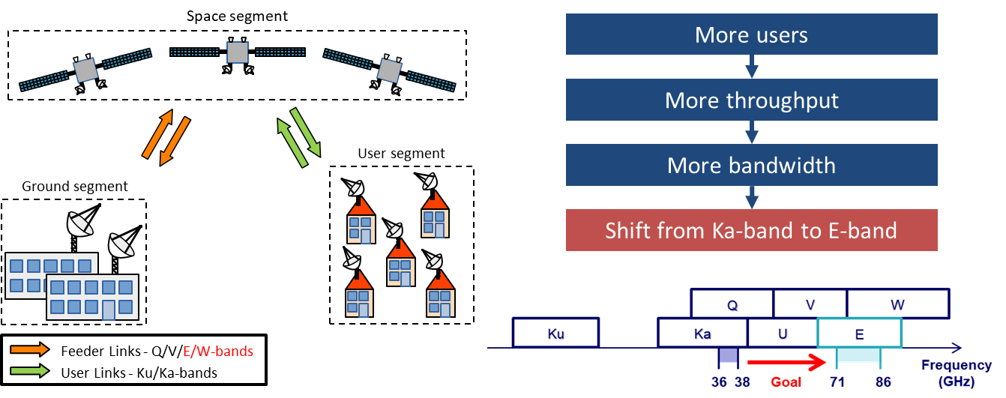
Context

Slide 5
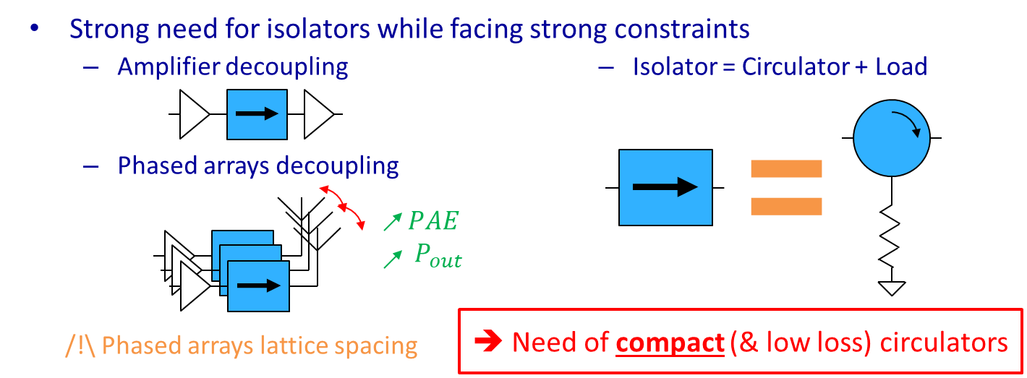
Context

Slide 6
Outline
Context
Self-biased circulators principle
W-band rectangular waveguide circulator
W-band planar isolator
Conclusions and prospects

Slide 7
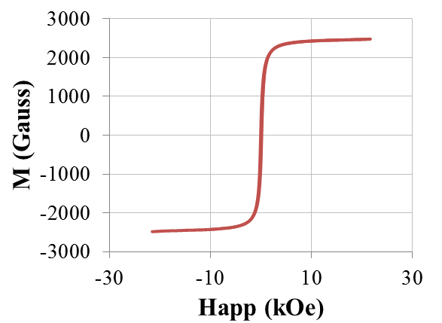
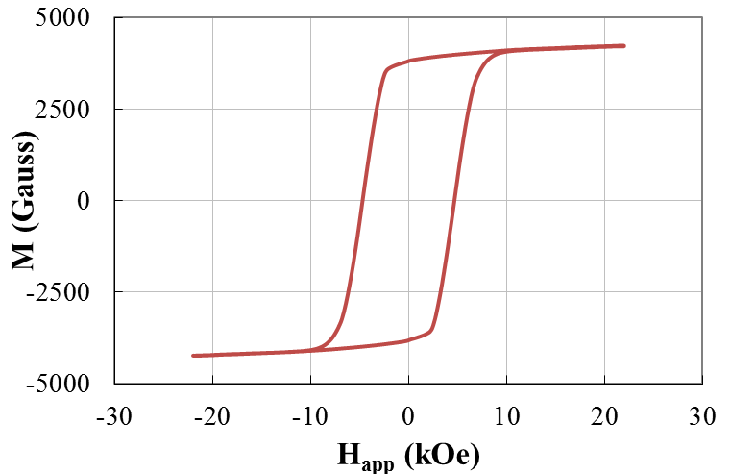
Self-biased circulator principle
Standard circulator
Self-biased circulator
Permanent magnet
Microstrip Y-junction
Magnet
H_{app}
H_{app}
Dielectric
Ferrite
Hysteresis cycle of a soft ferrite
Hysteresis cycle of a pre-oriented hexaferrite
Soft ferrite
Magnetization state: saturation
Need a permanent magnet
Pre-oriented hexaferrite
Magnetization state: remanence
No permanent magnet
Easier integration

Slide 8
Outline
Context
Self-biased circulators principle
W-band rectangular waveguide circulator
W-band planar isolator
Conclusions and prospects

Slide 9
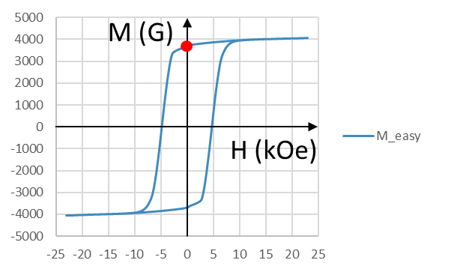
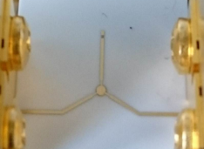
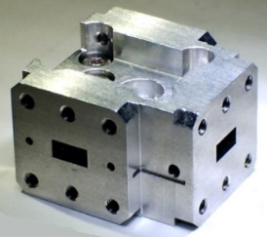
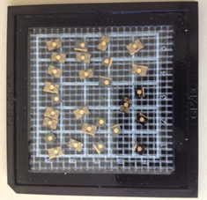
W-band rectangular waveguide circulator
Selection of a pre-oriented strontium hexaferrite
Previous successfull demonstration in Ku, Ka and Q band
Laur et al. IEEE TMTT 2015
Noutehou et al. SPCD 2018
Parker et al. IEEE TMAG 2021
Parker et al. IMS 2023
Roué et al. EuMW 2023
Material | $$ε_{r}$$ | $$tan δ_{e}$$ | $$4πM_{r} (G)$$ | $$M_{r}/M_{s}$$ | $$H_{k} (kOe)$$ | $$ΔH (Oe)$$
SrM | 21.3 | 5.10⁻⁴ | 4080 | > 0.85 | 17.5 | 200 @ 45 GHz

Slide 10
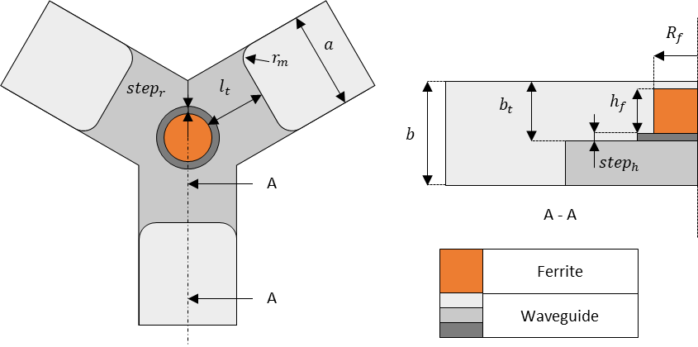
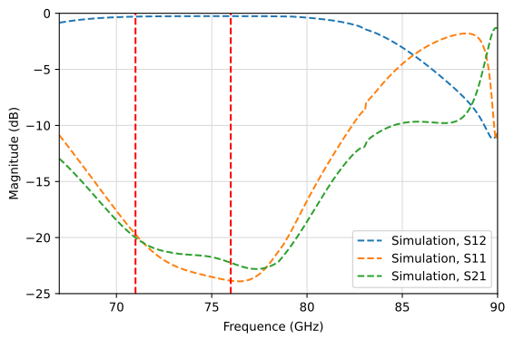
W-band rectangular waveguide circulator
Design and simulation:
Y junction circulator in WR-12 waveguide (60-90 GHz) with quarter-wavelength lines
Ferrite disk dimensions: R_{f} = 0.42 mm, h_{f} = 0.6 mm
Preliminary design (Linkhart formulas) and Ansys HFSS optimization
In simulation: IL < 0.3 dB and Isolation > 20 dB from 71-76 GHz

Slide 11
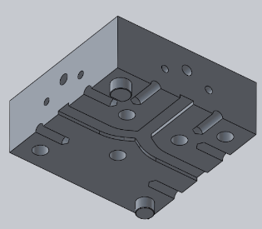
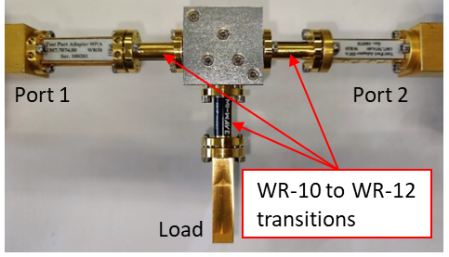
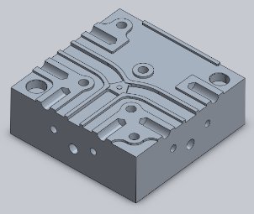
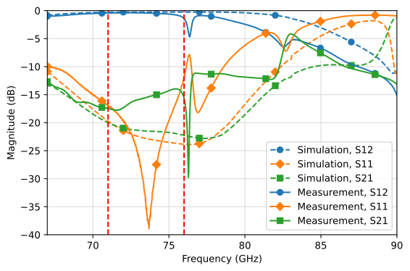
W-band rectangular waveguide circulator
Fabrication and measurements:
Component housing made of two blocks
Machined in aluminum with a silver coating (t > 5 µm)
Ferrite disk manually stuck at the center of the Y-junction
Fairly good agreement between simulation and measurement (slight shift toward low frequencies)
IL_{min} = 0.37 dB at 71.6 GHz
IL < 1.45 dB and Isolation > 14.8 dB between 71 and 76 GHz

Slide 12
Outline
Context
Self-biased circulators principle
W-band rectangular waveguide circulator
W-band planar isolator
Conclusions and prospects

Slide 13
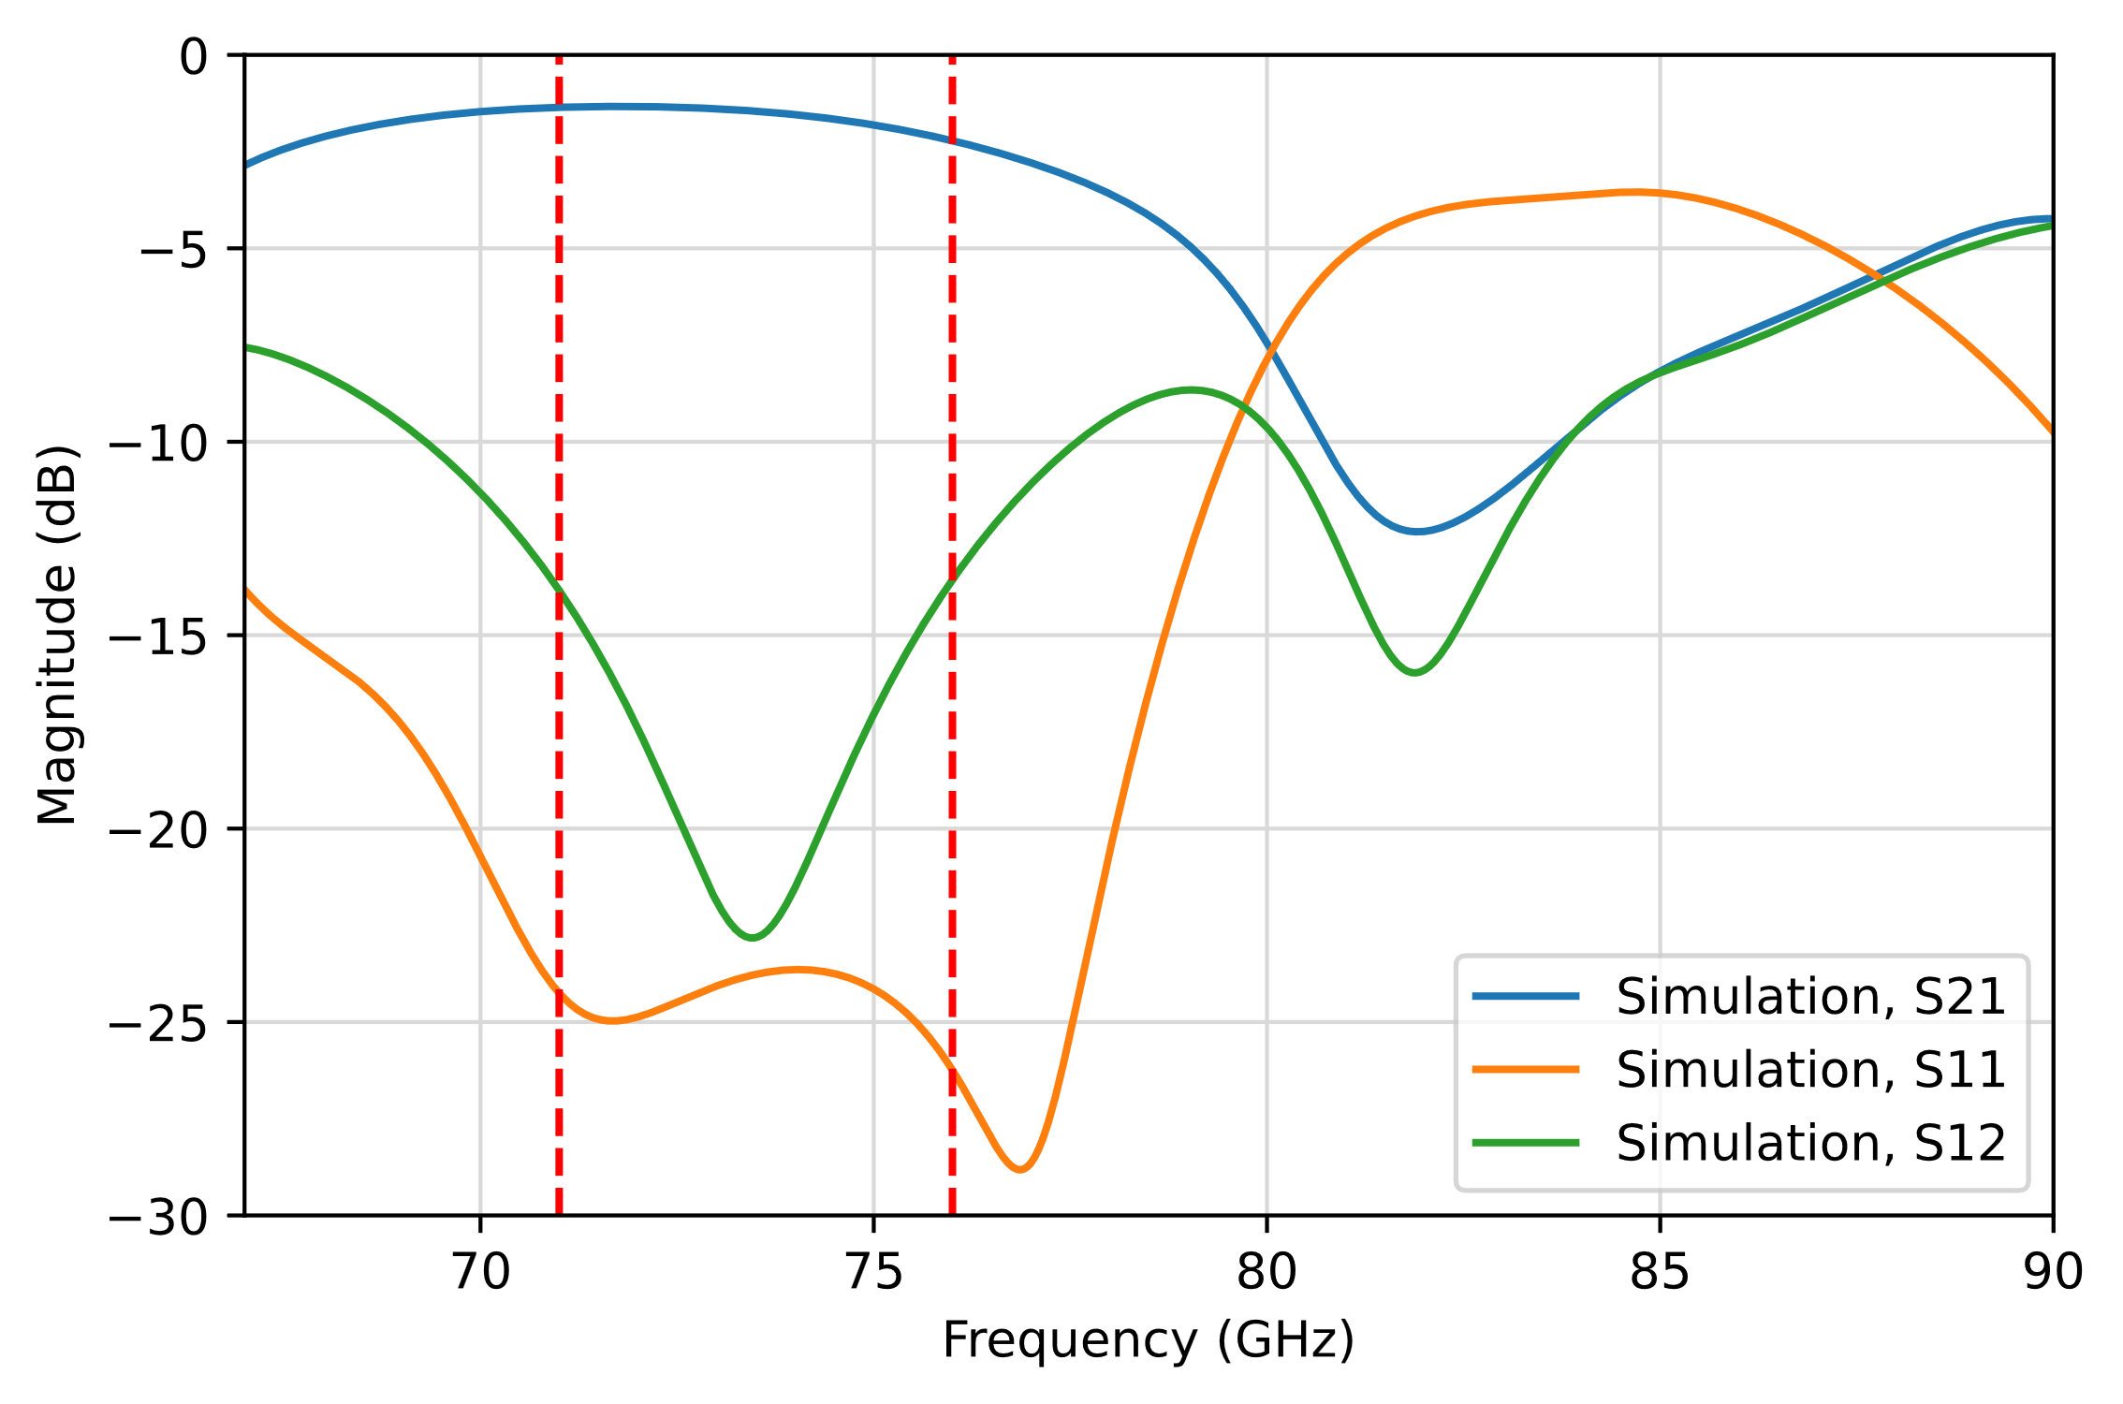
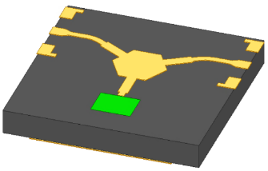
W-band planar isolator
Isolator design due to measurement limitation (2 ports measurements only) ⇒ Circulator + 50Ω load
Y-junction in microstrip technology with quarter wavelength impedance transformers
Integration of coplanar-to-microstrip transitions (measurements using a probe station)
50Ω load: Ta₂N resistive layer
71-76 GHz:
IL < 2.22 dB
Iso >13.5 dB
RL > 23.7 dB
1.2 mm
1.2 mm

Slide 14
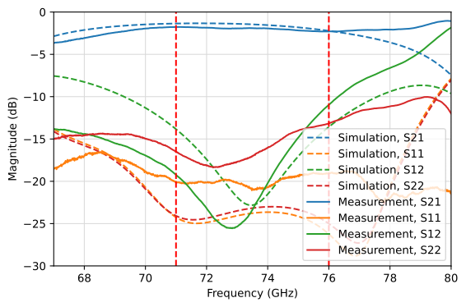
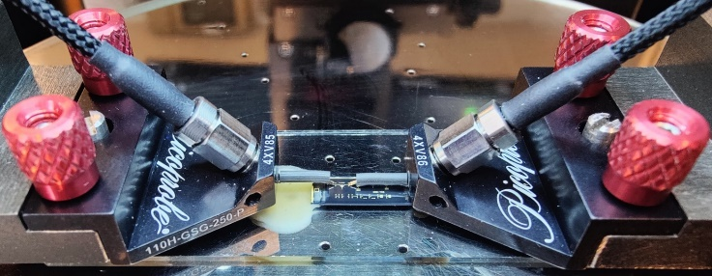
W-band planar isolator
Fabrication: machining and polishing, standard thin film process
Measurement: ZVA-67 with ZVA-110 frequency converters, Microtest probe station
Quite good agreement between measurement and simulation but slight shift toward low frequencies
IL < 2.29 dB and Isolation > 10.9 dB in the 71-76 GHz frequency band

Slide 15
Outline
Context
Self-biased circulators principle
W-band rectangular waveguide circulator
W-band planar isolator
Conclusions and prospects

Slide 16
Conclusion and prospects
Experimental demonstration of W-band self-biased circulators and isolators with state-of-the-art performance
Rectangular waveguide ⇒ Comùpetitive with standard technology (spinel ferrites with permanent magnet)
Microstrip ⇒ Promising results / Requires better control of design and process
w/ H field
w/o H field
This work
w/ H field
w/o H field
This work

Slide 17
Towards W-band self-biased circulators for next generation of VHTS payload
E. Roué
Thank you for your attention

